Slide 1
Text2Human: Text-Driven Controllable Human Image Generation
Group member:
Long Pan(21332147)
Nitin Frederick(21330025)
Weiwei Wan(22301337)
Shuo Jia(22301057)
Group 6
Notes:
Our paper is Text2Human: Text-Driven Controllable Human Image Generation.
(Click!!)
First of all, let me introduce what it is.

Slide 2
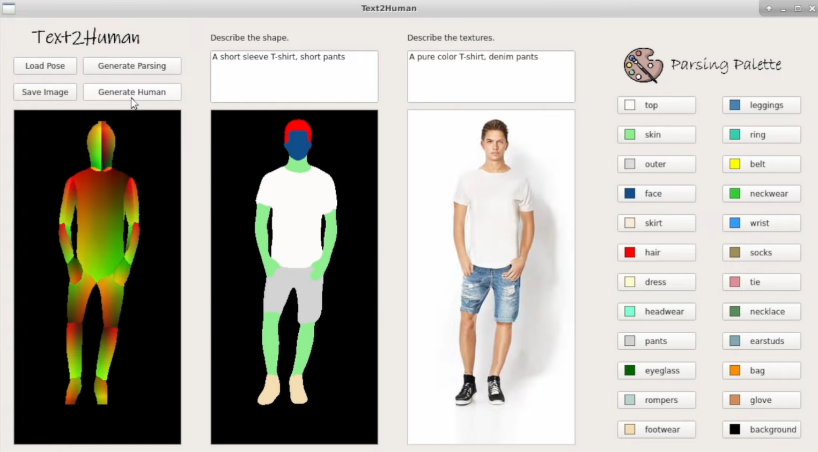
Introduction
History
Significance
Introduction
What it is?
It is desirable to intuitively control the synthesized human images for layman users.
Notes:
It is desirable to intuitively control the synthesized human images for layman users.
(Click it!)
For example, they may want to generate a person wearing a floral T-shirt and jeans without expert software knowledge.
This is why text2human was created, and human image generation with explicit textual controls
(Click it!)
makes it possible for users to create 2D avatars more easily.

Slide 3
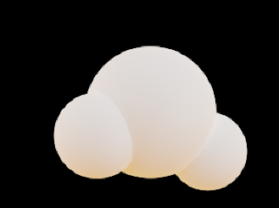
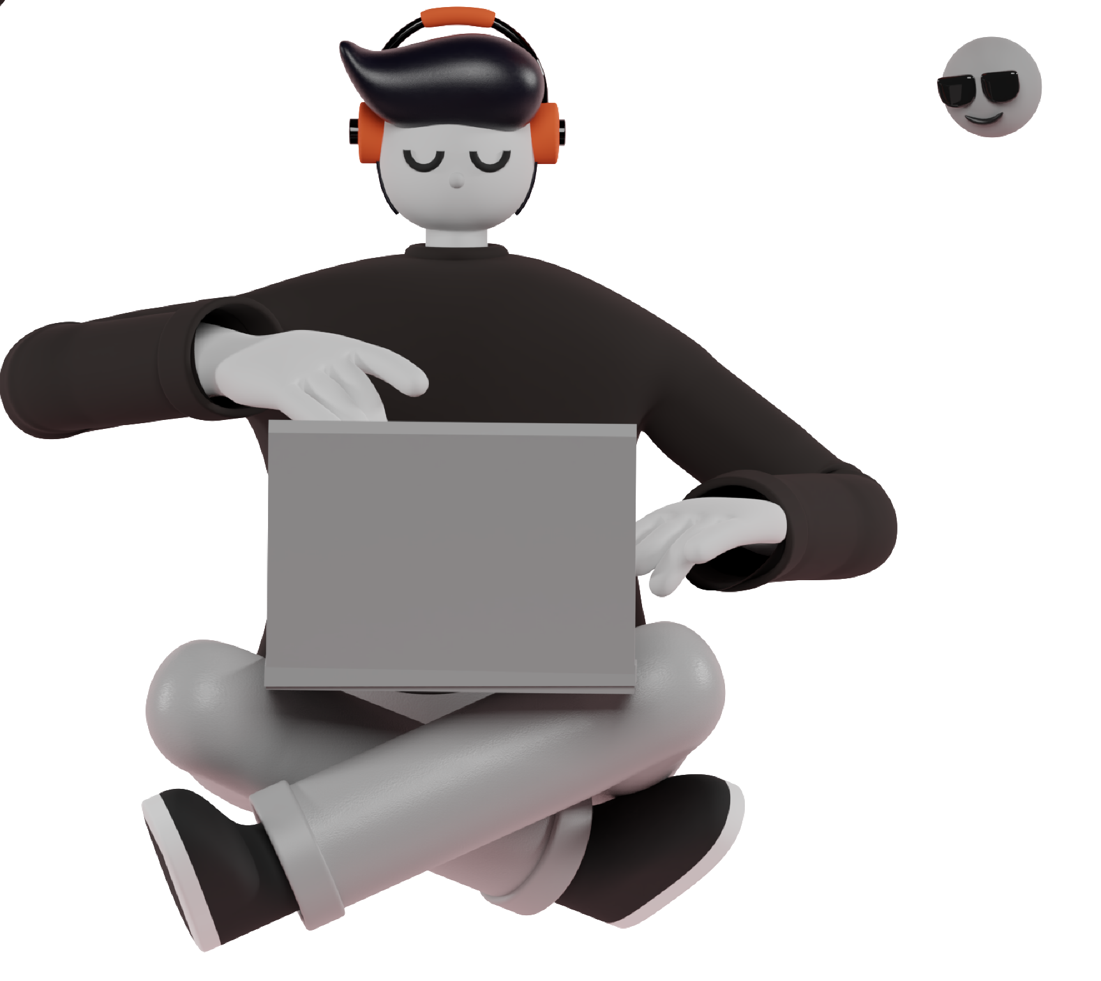
Introduction
History
Significance
Introduction
How it works?
Generate a human parsing mask with diverse clothes shapes based on the given human pose and user-specified texts describing the clothes shapes.
Enrich the human parsing mask with diverse textures of clothes based on texts describing the clothes textures.
Notes:
So how it works? It has two stages.
First, it generates a human parsing mask / with diverse clothes shapes /
based on the given human pose / and user-specified texts /
describing the clothes shapes.
Second, it enriches the human parsing mask / with diverse textures of clothes /
based on texts / describing the clothes textures.

Slide 4

Importance and History
Generative Adversarial Network (GAN)
Rapid development
First generative in 2014, different variants of GAN have been proposed after that.
It has powerful capabilities in generating high-fidelity images.
Conditional GANs
Text2Human
conditional GANs were proposed to generate images based on conditions like segmentation mask and natural language.
a conditional image generation framework by taking human poses and texts as inputs.
Notes:
Now, I’ll introduce the history of Text2Human
There is a technology ………
It’s first generated in 2014, Then……….
In addition to unconditional generation, conditional GANs…..
Text2Human is a conditional image generation framework by taking human poses and texts as inputs. And the Text2Human framework was generated for the text-driven controllable human image generation. Given a human pose, users can specify the clothes shapes and textures using solely natural language descriptions. Human images are then synthesized in accordance with the textual requests.

Slide 5
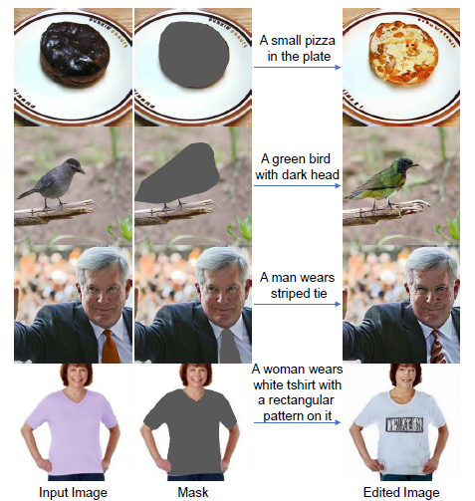
Industry and Societal Significance
Generating high-quality and diverse human images is an important yet challenging task in vision and graphics.
Virtual try-on to improve customer shopping experience.
Human pose transfer.
Virtual and augmented reality.
Data generation and augmentation for neural network training.
Animations

Slide 6

Vector Quantized Diffusion Model for Text-to-Image Synthesis
The core design is to model the vector quantized variational autoencoder (VQ-VAE) latent space in a non-autoregressive manner by using a diffusion model.
The VQ-Diffusion model is well-suited for text-to-image generation tasks because it eliminates the unidirectional bias with existing methods.

Slide 7
Method
VQ-VAE turns continuous word embeddings into a few simple and discrete representations.
VQ-Diffusion model samples the data distribution by reversing a forward diffusion process that gradually corrupts the input via a fixed Markov chain.

Slide 8
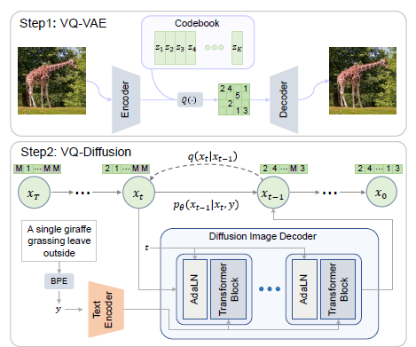
Method
VQ-Diffusion framework
Text encoder
takes the text tokens y and yields a conditional feature sequence.
Diffusion image decoder
takes the image token xt and timestep t and outputs the noiseless token distribution.

Slide 9
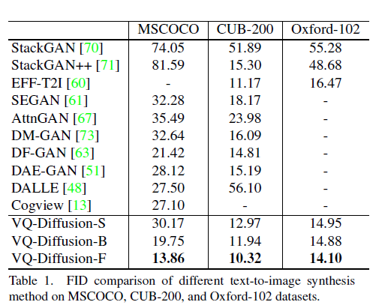
Datasets
Experiments and Results
CUB-200 [66], Oxford-102 [40], and MSCOCO containing images and text descriptions.
Three diffusion models
VQ-Diffusion-S (Small), VQ-Diffusion-B (Base) and VQ-Diffusion-F (Large)
Evaluation Metric
Fréchet Inception Distance (FID)
Method Comparison

Slide 10
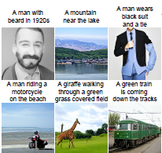
Error optimization
Contribution to State of the Art
The mask-and-replace diffusion strategy avoids the accumulation of errors of the AR model.
Higher Quality
More complex scenes, improves the synthesized image quality and faster speed
Faster speed
Faster sampling speed because the indices are predicted in parallel.
Method Comparison

Slide 11
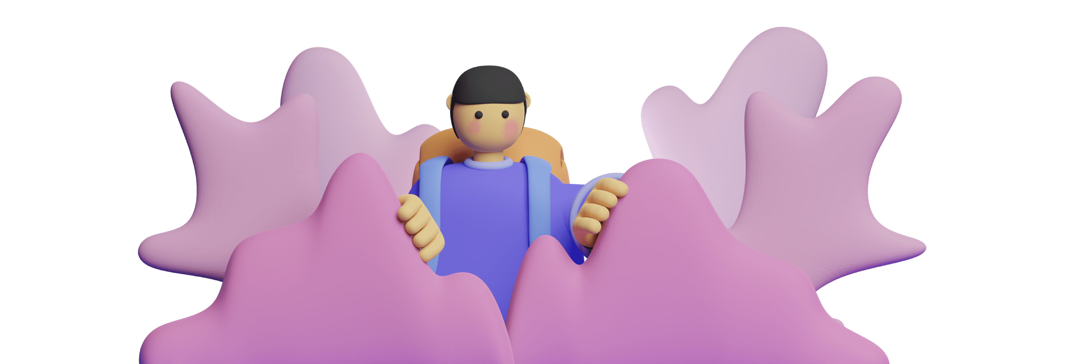
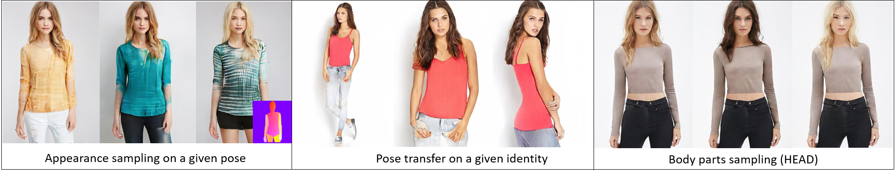
HumanGAN: A Generative Model of Human Images
Human image generation framework
Full-body images of clothed humans
Notes:
May paper is HumanGAN: A Generative Model of Human Images, the GAN technology we have mentioned above
1-This paper presented a human image generation framework for full-body images of clothed humans called HumanGAN, which enables control of body pose, as well as independent control and sampling of appearance and clothing style on a body part level. 1-This pose-guided generative model can sample random appearances conditioned on a given pose (left), create persistent appearance and identity across different poses (middle), and sample body parts (right).

Slide 12
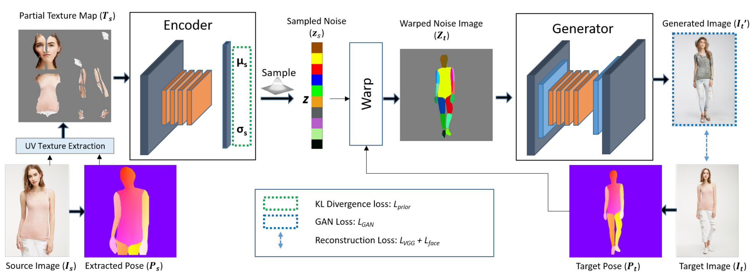

Method overview
Notes:
Now I’ll talk about the method this paper used. From the source image Is, UV texture map of the human appearance Ts was extracted. The encoder then encodes Ts to part-specific latent vectors zs. The target pose Pt is used to warp and broadcast the latent vectors to the corresponding parts in the target image to create a noise image Zt. Finally, the generator converts Zt to a realistic image.

Slide 13
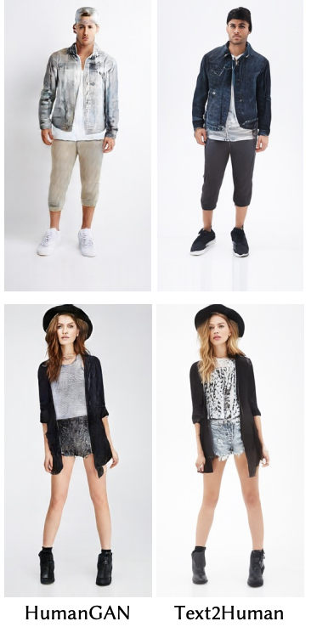
Comparison
HumanGAN
Text2Human
HumanGAN
Text2Human
Human generation by giving texts
Easier to change cloth texture
Notes:
On the body pose and cloth style generating part, Text2Human and HumanGAN could be compared and HumanGAN is a state-of-the-art method in this area. Text2Human framework allows for controllable human generation by giving texts describing the desired attributes and it’s easier to change cloth texture. However, HumanGAN didn’t do that. In the Text2Human paper, they also compared the two frameworks.

Slide 14
Dressing in order: recurrent person image generation for pose transfer virtual try-on and outfit editing
Recurrent person image generation for pose transfer virtual try-on and outfit editing.
Multiple layouts
Pose Transfer
Outfit Editing
Notes:
My paper is Dressing in order: recurrent person image generation for pose transfer virtual try-on and outfit editing
Different from the main topic paper, this paper not only focuses on encoding pose, skin and garments, but also pays attention to the order when putting on garments.
And it is designed for multiple fashion tasks including virtual try-on. (Click!!)
---
let's assume we have a source person and two garments to try on.

Slide 15
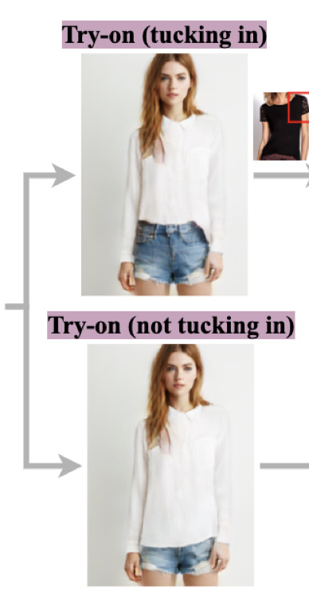
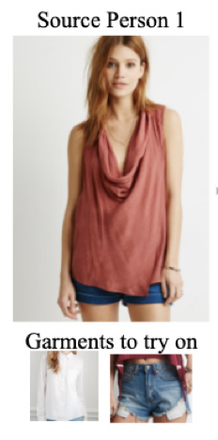
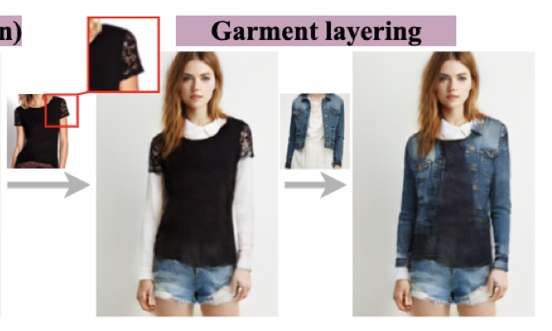
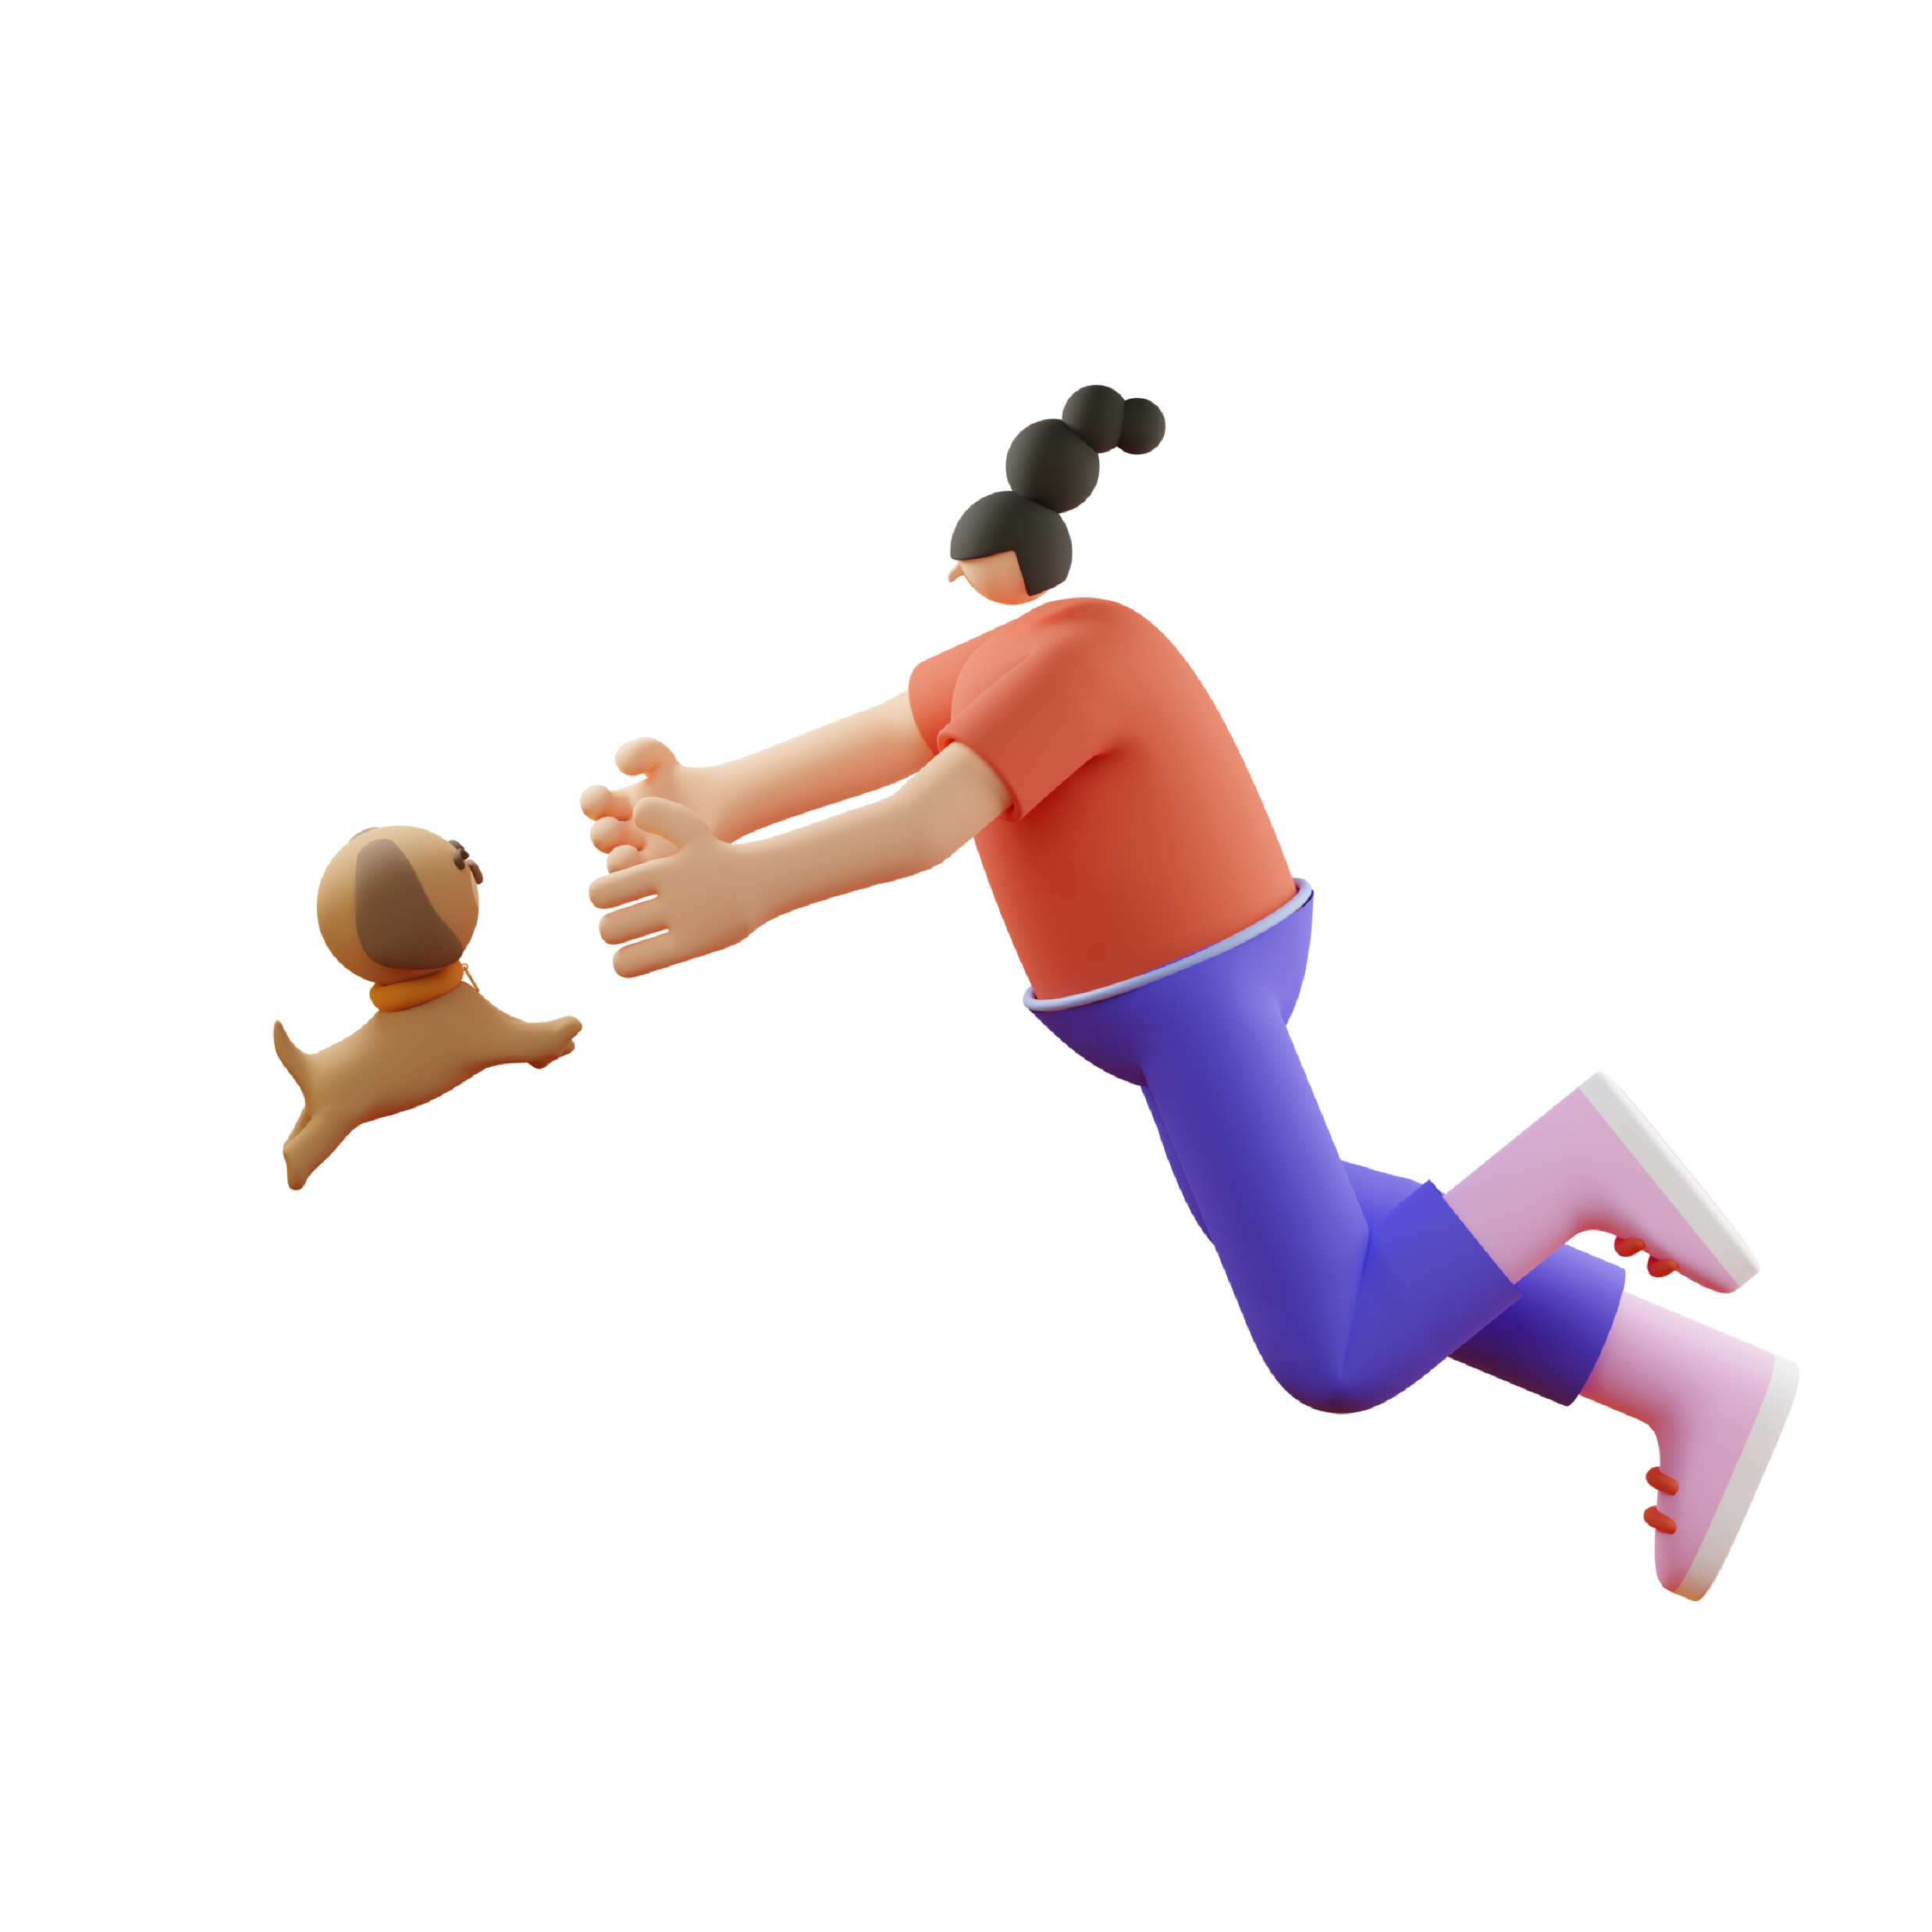
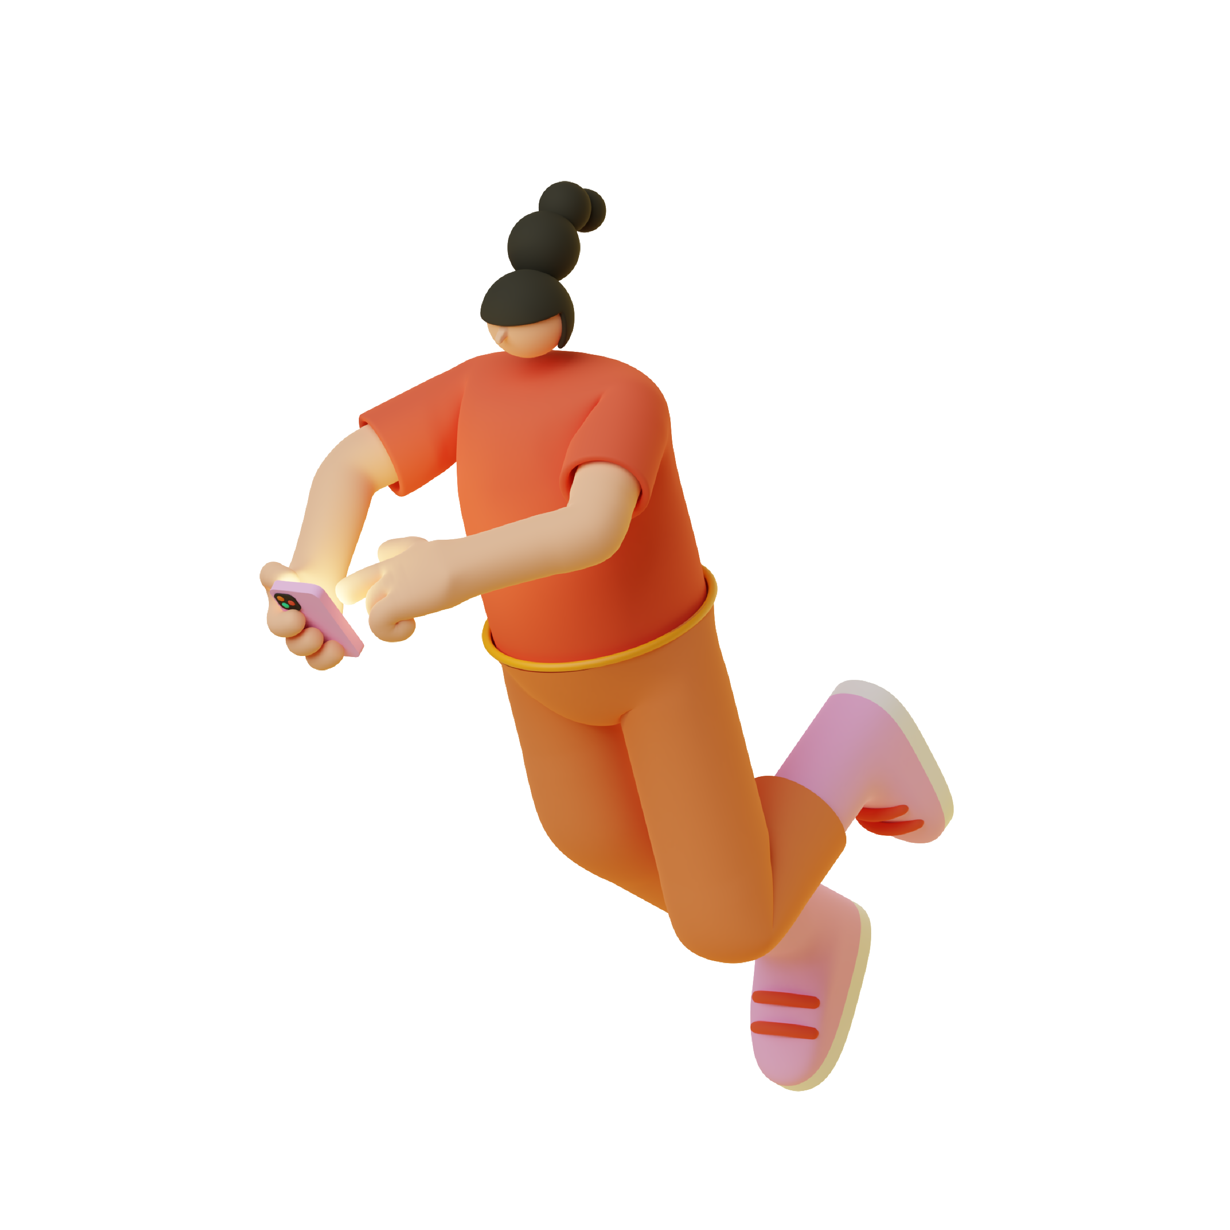
Extend virtual try-on to support
Multiple layouts
and Multiple layers
Notes:
let's assume we have a source person and two garments to try on.
Dressing in order can let the user to decide what order they want to put on, the shirt or the pants.
As a result, it will generate either tucking-in result or not tucking-in result.
Besides that we can also keep layering additional garments on the existing outfits.
In this way it can achieve both multiple layering and multiple layouts. (click!!)
---
The key for dressing in order to work on multiple tasks is a recurrent pipeline.

Slide 16
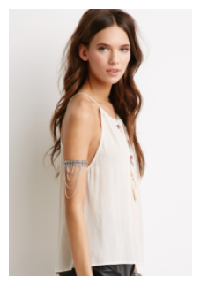
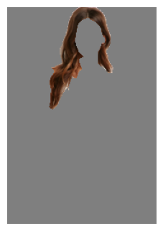
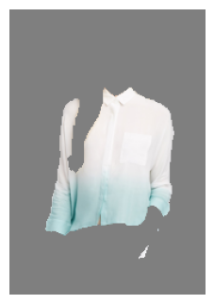
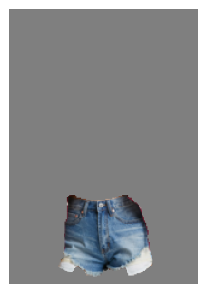
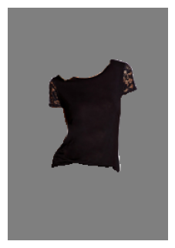
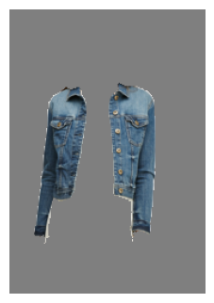
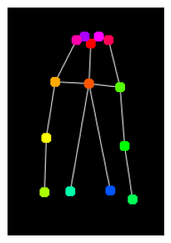
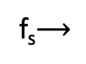
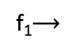
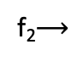
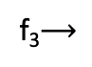
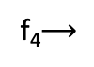
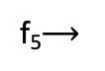
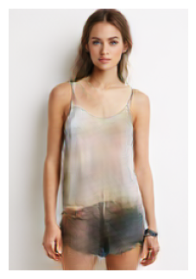
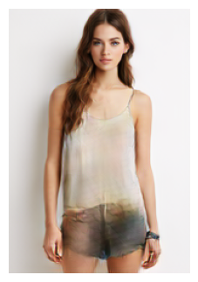
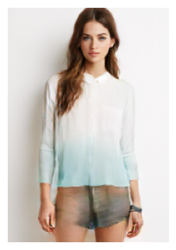
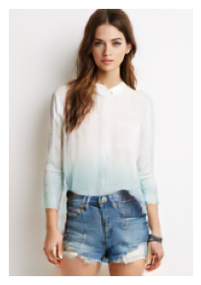
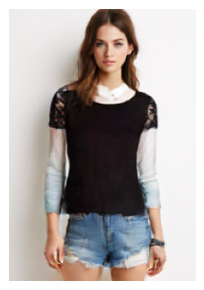
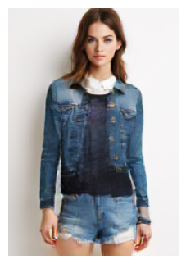
A recurrent mechanism
Body
Garment1
Garment2
Garment3
Garment4
Garment5
Target Pose
E_{body}
E_{seg}
E_{seg}
E_{seg}
E_{seg}
E_{seg}
G_{body}
G_{gar}
G_{gar}
G_{gar}
G_{gar}
G_{gar}
…..
G_{dec}
G_{dec}
G_{dec}
G_{dec}
G_{dec}
G_{dec}
Notes:
The key for dressing in order to work on multiple tasks is a recurrent pipeline.
The generation starts with a target pose and the source person. The first thing it does is to extract the skin region from the source person, and render the source person in the target pose. Next, for every garment that we are interested, it will separately encode its shape and texture. (Click it !!)
And it uses a generator called "G_gar" to put it back on the person. the "G_gar" will be recurrently running for every new garment, so it can sequentially layer in garments one by one.
Technically we can keep running this step as many times as we want. Because this is a recurrent mechanism with such a pipeline.
---
We can use every component to achieve different applications.

Slide 17
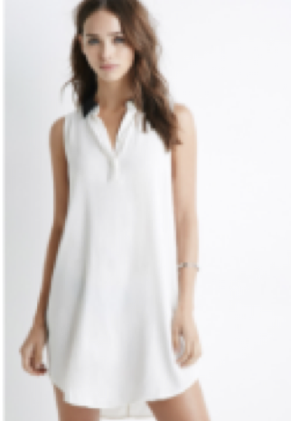
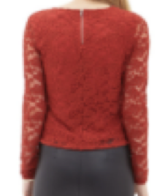
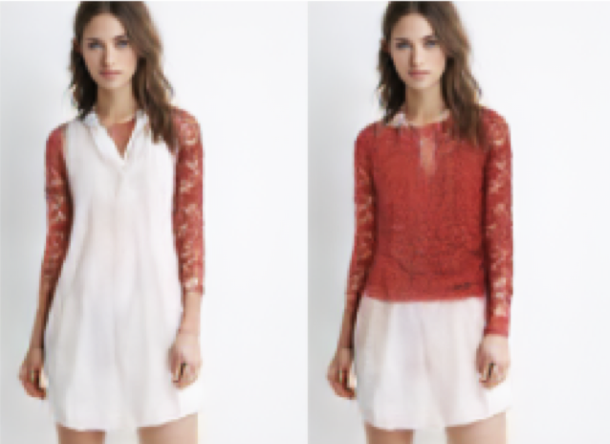
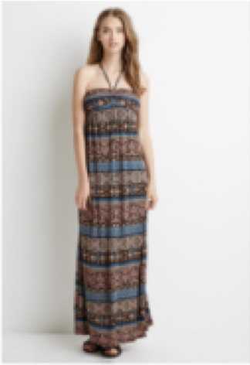
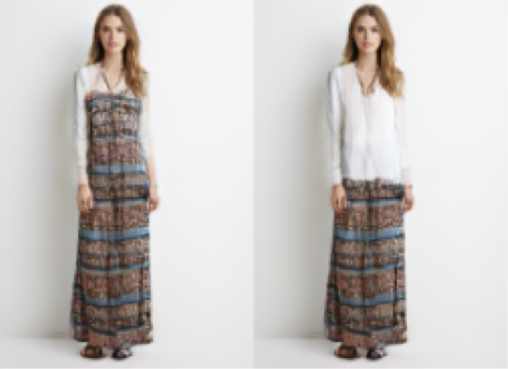
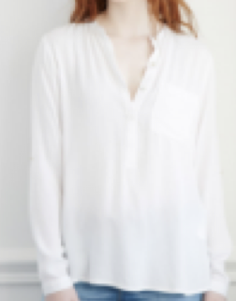
Applications
Pose transfer
Layer inside vs. outside
Person
Poses
Transferred
Notes:
We can use every component to achieve different applications.
For example we can achieve pose transfer by using this target pose input. Also, we can use the dressing order. (Click!!)
---
In addition, it can preserve more details in terms of shape and texture, more results about the try-on,

Slide 18
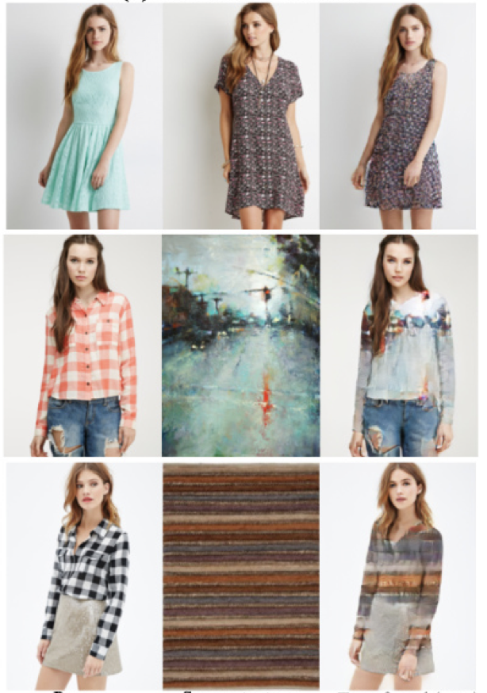
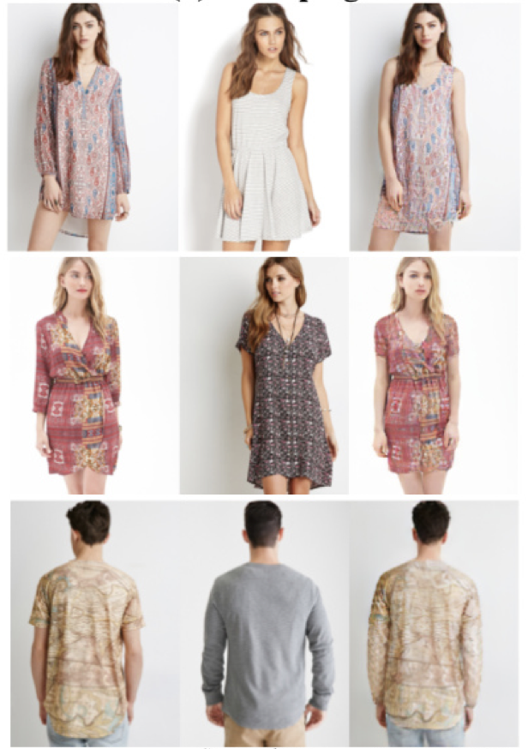
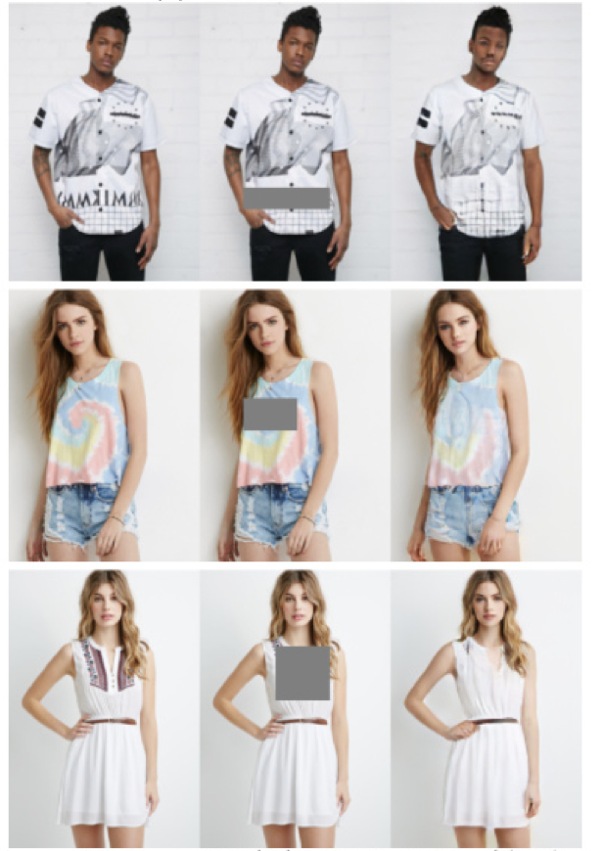
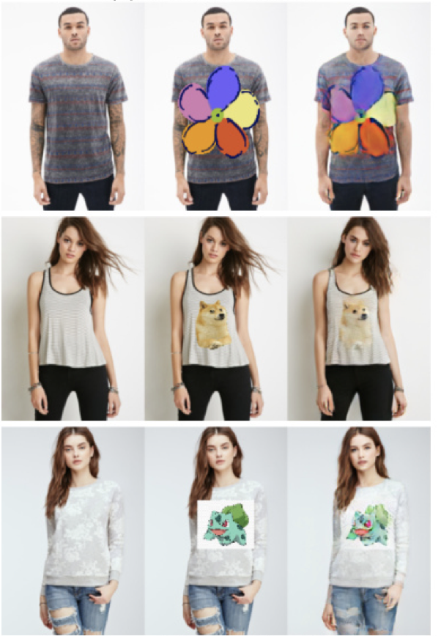
Applications
Texture Transfer
Reshaping
Content Removal
Print Insertion
Input
Texture
Transferred
Input
Shape
Reshaped
Input
Masked
Removed
Input
C&V
Inserted
Notes:
In addition, it can preserve more details in terms of shape and texture, more results about the try-on,
including try-on with different layout, layering inside and keep layering outside,
more results about editing, including texture transfer, reshaping, content removal and content insertion.

Slide 19

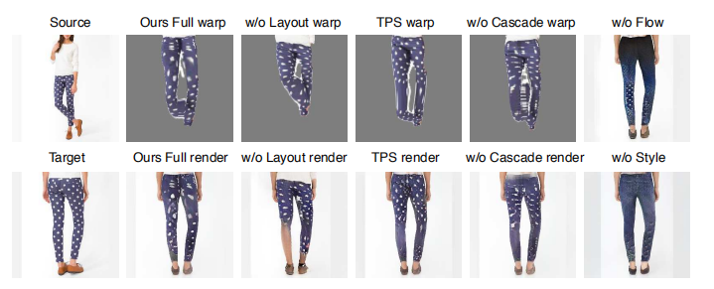
ClothFlow
ClothFlow: A Flow-Based Model for Clothed Person Generation

Slide 20
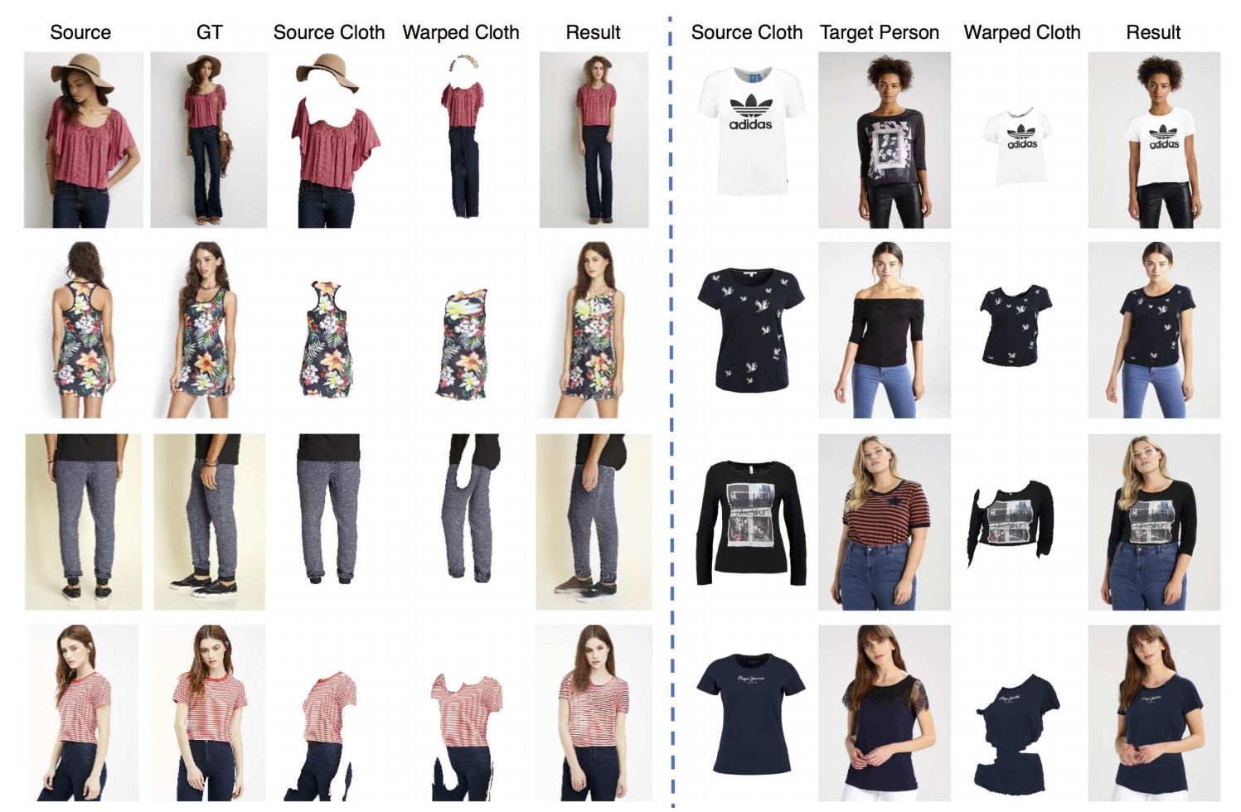
ClothFlow
Left:
pose-guided person image generation
Right:
virtual try-on
Results of ClothFlow
An appearance-flow-based generative model capable of better generating images of people in target poses wearing active clothing by accurately estimating clothing deformations between source and target images.

Slide 21
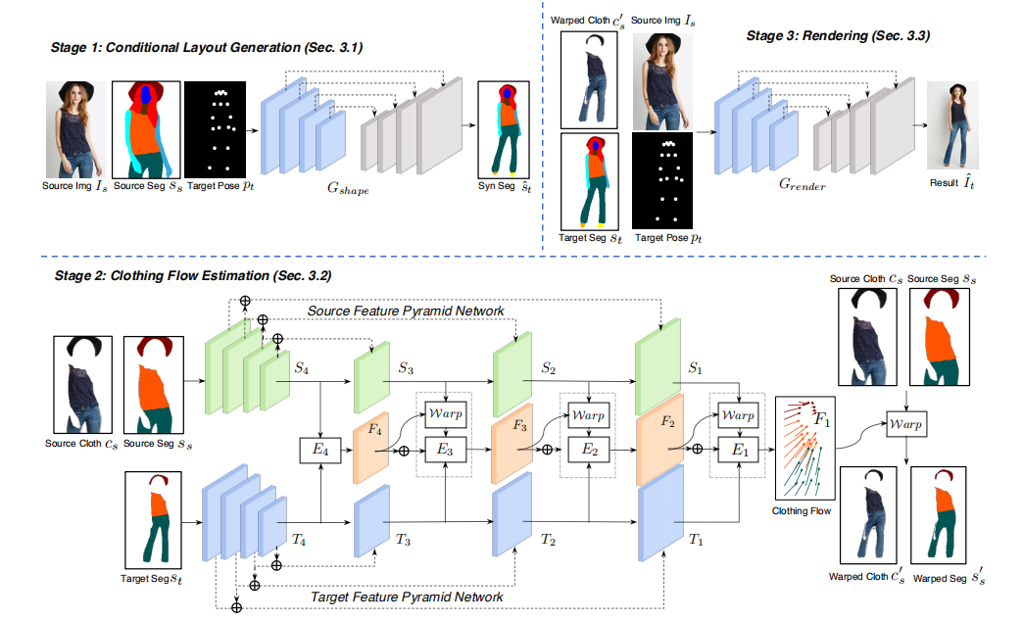
Principle
Stage 1
Estimating the Semantic Layout Information of a Human Target Pose
Framework of ClothFlow
Cascade Flow Estimation Network
Appearance Matching
Dense Flow Field
Image Deformation Calculation

Slide 22
Estimating the Semantic Layout Information of a Human Target Pose
Principle
Stage 2
Cascade Flow Estimation Network
Appearance Matching
Dense Flow Field
Image Deformation Calculation
Framework of ClothFlow
Generation Network
Input: the clothing area
Output: the rendered target view

Slide 23
Cascade Flow Estimation Network
Appearance Matching
Dense Flow Field
Image Deformation Calculation
Principle
Stage 3
Generation Network
Input: the clothing area
Output: the rendered target view
Framework of ClothFlow

Slide 24
In Methods
Precise flow fields for appearance transformations are predicted in a cascaded manner.
At each cascading stage, the feature deformation module progressively improves the estimation results of the previous stages.
contributions
DeepFashion:
ClothFlow can better preserve clothing details based on pose-guided image synthesis, making the generated images more realistic.
VITON:
The virtual fitting experiment on this data set also achieved good results.

Slide 25

In Experiments
DeepFashion:
ClothFlow can better preserve clothing details based on pose-guided image synthesis, making the generated images more realistic.
VITON:
The virtual fitting experiment on this data set also achieved good results.
contributions
Precise flow fields for appearance transformations are predicted in a cascaded manner.
At each cascading stage, the feature deformation module progressively improves the estimation results of the previous stages.

Slide 26
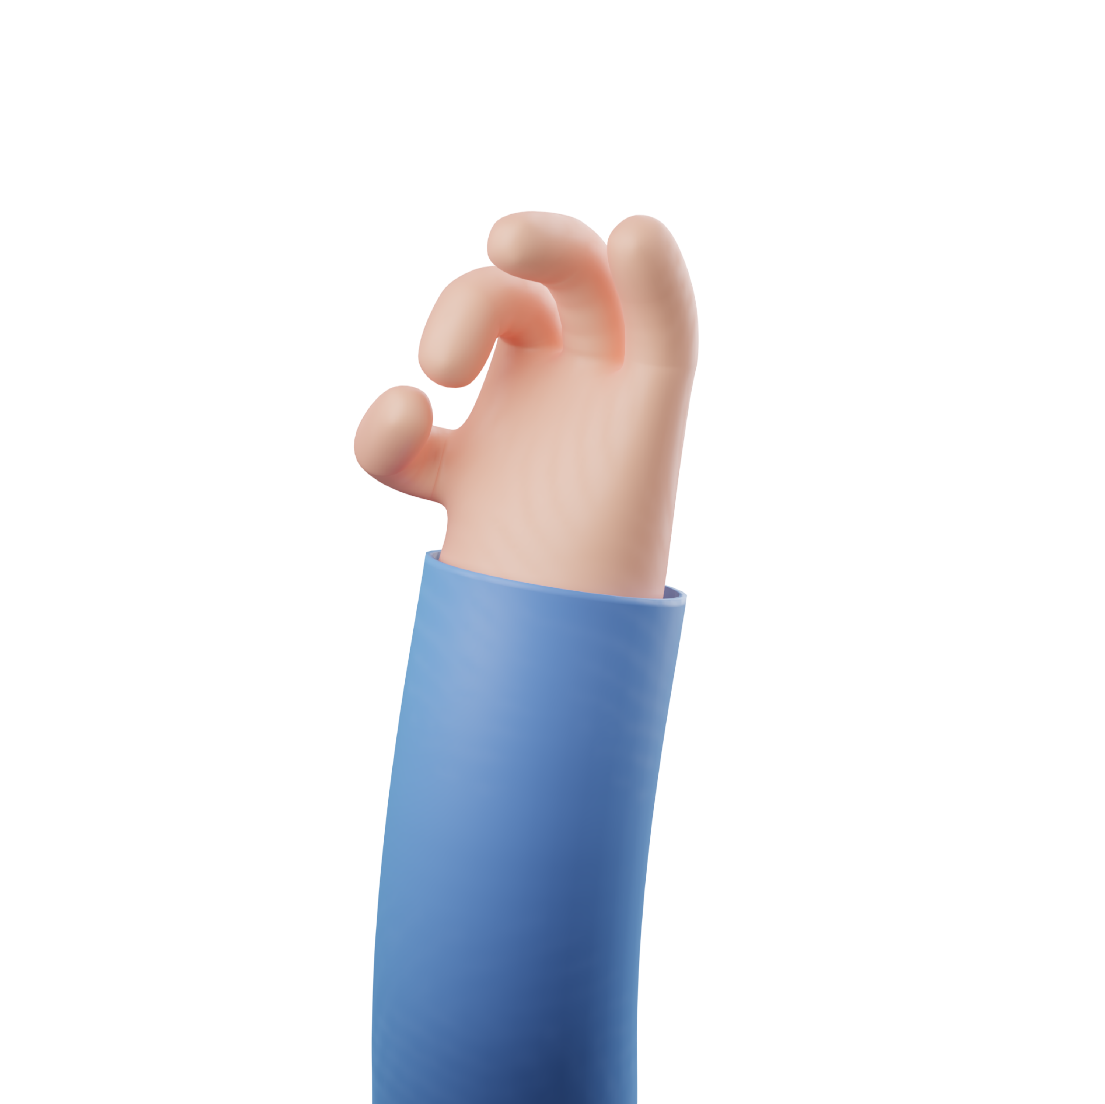
Conclusion
Dressing in Order
HumanGAN
Text2human
VQ-Diffusion Model
ClothFlow

Slide 27
Thank You
Group member:
Long Pan(21332147)
Nitin Frederick(21330025)
Weiwei Wan(22301337)
Shuo Jia(22301057)
Group 6
PPT Producer: Long Pan

